Slide 1
M
Pale yellow: #F6FBD7
Tan/brown: #C59D5F
Gray: #F2F2F2

Slide 2

molecoder. M | Project and coordination | HBSc., MSc.
mobile: just text and logo underneath
Web: looks like business card that flips on hover to logo side
No header unless decide to add nav in the future.
Section = header
*section 100vh and vw

Slide 3
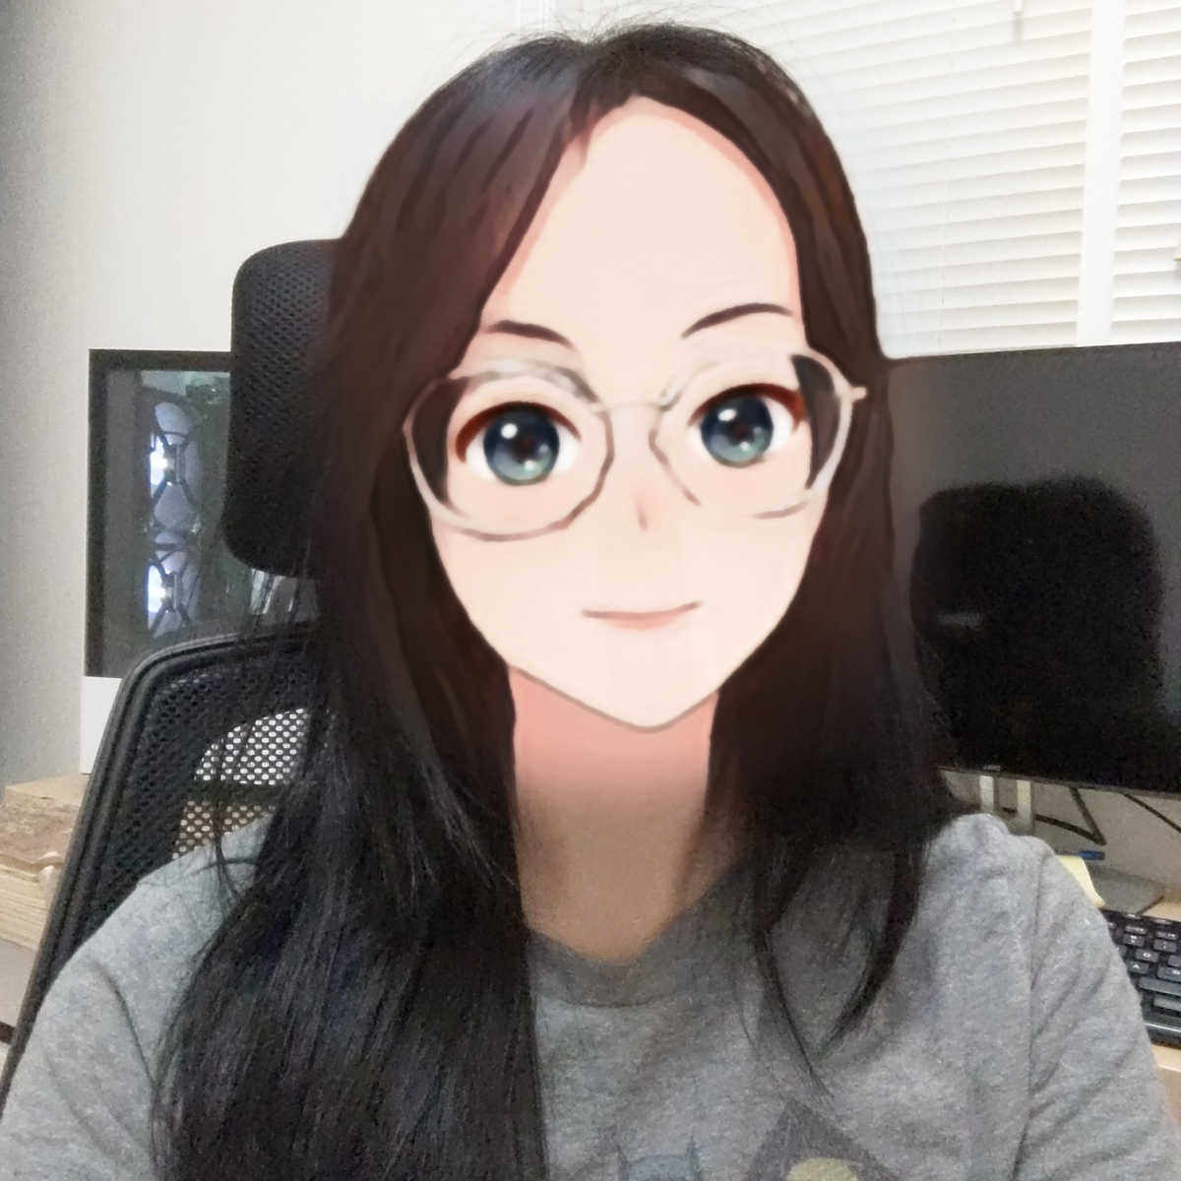
About.
Self-teaching (note: present tense) coder with a knack for analyzing and optimizing workflow processes.
I have always been interested in software design to improve user experience whether it’s running chromatography, 3D-printing, or project coordination.
mobile: everything aligns vertically
Web: pictures align horizontally
Sections: about, mission, explore
*sections100vh and vw
Mission.
What is molecoder?
Molecoder is a play on the word 'molecular' combining my enthusiam for science and coding.
What do I do on here?
Starting with front-end development and running towards fullstack one day. Documenting all my progress online.
Explore.
Find my personal projects
and all things digital here:
Portfolio
molec 2024.

Slide 4
Mobile vers:
Mission.
molecoder. M | Project and coordination | HBSc., MSc.
What is molecoder?
Molecoder is a play on the word 'molecular' combining my enthusiasm for science and language.
What do I do on here?
Starting with front-end development and running towards full-stack one day. Documenting all my progress online.
Explore.
Find my personal projects and all things digital here:
Portfolio
About.
Self-teaching (note: present tense) coder with a knack for optimizing workflow processes and learning new languages.
I have always been interested in software design to improve user experience whether it’s running chromatography, 3D-printing, or implementing it somehow with project coordination.
molec 2024.

